Slide 1

Stock Price Prediction Program
Guided by : Mr. Hardik P. Jagad
Prepared by : Sarvik A. Vaghasiya
: Hardey N. Pandya

Slide 2
Introduction of system :
Stock Market prediction and analysis is the act of trying to determine the future value of a company stock or other financial instrument traded on an exchange. Stock market is the important part of economy of the country and plays a vital role in growth of the industry and commerce of the country. Both investors and industry are involved in stock market and wants to know whether some stock will rise or fall over certain period of time.
The opportunity to expand our knowledge in finance and investing, as we had only little prior exposure to these fields.
It possesses many theoretical and experimental challenges.

Slide 3
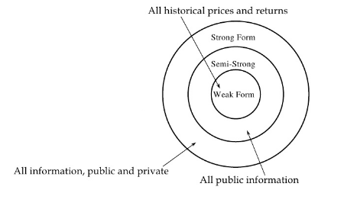
Efficient Market Hypothesis (EMH) :

Slide 4
Weak-form Efficient Market Hypothesis: The weak form of the hypothesis says that no one can profit from the stock market by looking at trends and patterns within the price of a product itself
Semi-Strong Efficient Market Hypothesis: The semi-strong form rules out all methods of prediction, except for insider trading.
Strong form Efficient Market Hypothesis: The strong form says that no one can profit from predicting the market, not even insider traders.

Slide 5
Criteria | Technical Analysis | Fundamental Analysis | Traditional Time Series Analysis
Data Used | Price, volume, highest, lowest prices. | Growth, dividend payment, sales level, interest rates, tax rates etc. | Historical data
Learning methods | Extraction of trading rules from charts | Simple trading rules extraction | Regression analysis on attributes is used
Type of Tools | Charts are used | Trading rules | RNN, ANN, Linear Regression, etc.
Implementation | Daily basis prediction | Long –term basis prediction | Long –term basis prediction

Slide 6
Purpose :
To identify factors affecting share market.
To generate the pattern from large datasets of NSE stock market for prediction.
To predict an approximate value of share price.
Regularly check the accuracy of the prediction.

Slide 7
Scope :
The objective of the system is to give an approximate idea of where the stock market might be headed. It does not give a long-term forecasting of a stock value. There are way too many reasons to acknowledge for the long-term output of a current stock.
Predicted and analysed data is also useful to Companies themselves. Company and industry can use it to stretch their limitations and enhance their stock value. It can be very useful to even researchers, stock brokers, market makers, government and general people.

Slide 8
Current system study :
Currently the systems use RNN, CNN, SVM to predict stock prices, with the advent in computational power of the computers. Computers with mediocre computational powers cannot perform heavy algorithms which involve complex neural networks.
The main disadvantage of all current systems is that once you define the model of prediction, you cannot change it. It may be result into heavy loss in the accuracy of the system. So, every current system tends not to follow EMH.

Slide 9
Requirement new system:
It is difficult to find existing systems that are both performance efficient and have high accuracy. Existing systems are also costly. By proposing new system which is open source and give sufficient amount of accuracy to its users will likely to be helpful to take them their decisions.

Slide 10
Tools and Technology / Minimum Hardware and Software Requirements:
Operating System: Windows 7 or later versions.
RAM: 2 GB or above.
Processor: Intel or AMD.

Slide 11
Tools and Technology used :
Python 3
PyCharm IDE
Python nsepy library
NumPy
Python pandas library
Python pyplot library
Python tkinter library
Scikit-learn
BeautifulSoup
PAGE: PAGE is a cross-platform drag-and- drop GUI generator
Tensorflow
Keras

Slide 12
Software Development Model :
The incremental model combines elements of linear sequential model with the iterative philosophy of prototyping. Each linear sequence produces a deliverable “increment” of the software. We call first increment as the core product. In core product, basic requirements are added but some unknown supplementary features will remain undelivered. This core product will be used by customer to evolute the system and next increment is planned to develop.

Slide 13
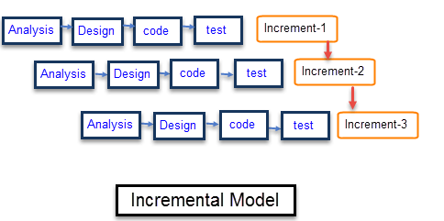

Slide 14
Functional requirements :
The system should be able to generate an approximate share price.
The system will also count technical indicators and judge according to those indicators.
The system will perform Textual analysis using online business articles and news.

Slide 15
Non functional requirements :
The system should provide better accuracy.
The system should have simple interface for users to use.
To perform efficiently in short amount of time.

Slide 16
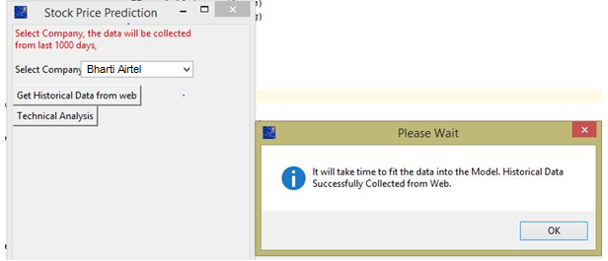
System GUI:

Slide 17
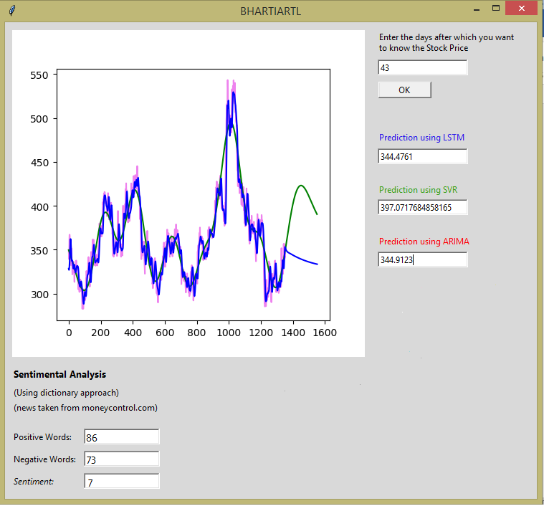

Slide 18
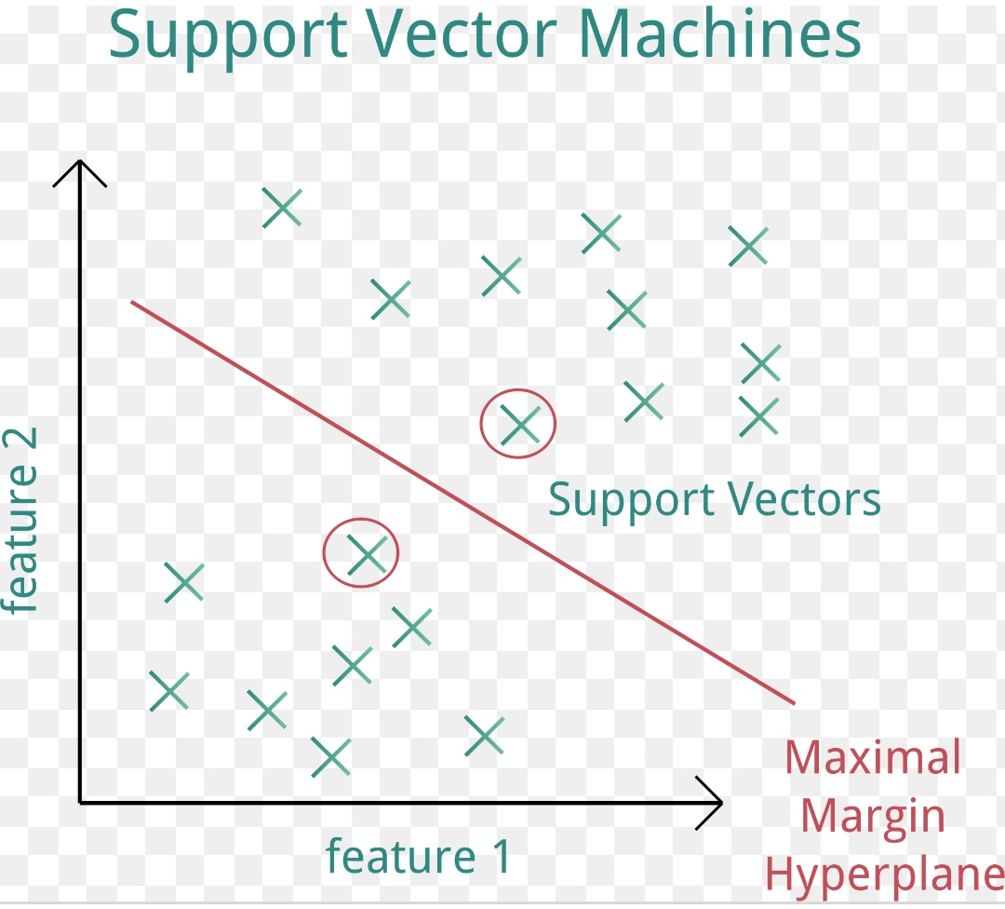
Support Vector Machine

Slide 19
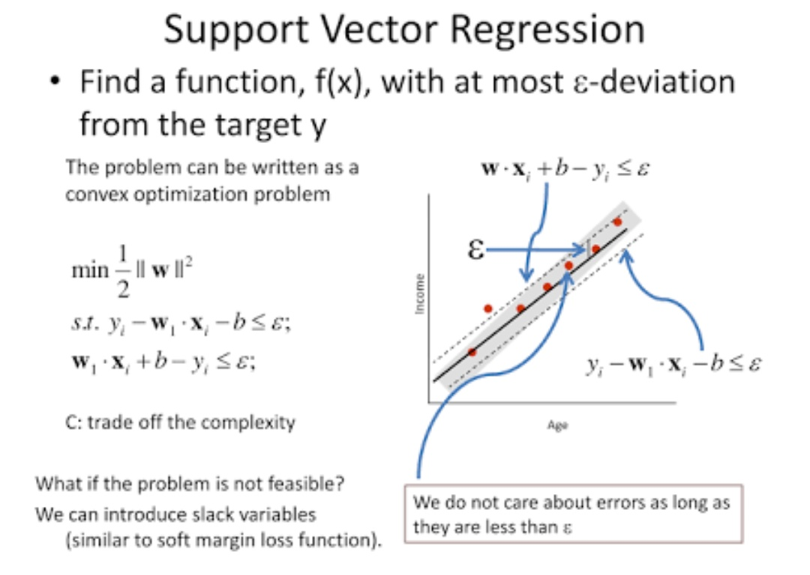
Support Vector Regression

Slide 20
Support Vector Regression
The RBF kernel function is the most widely applied in SVR. After we have our desired array we can start our operations. We are putting our values through SVR RBF. Then we are getting our desired values.
There are four common kernel functions; among these, this chapter will be utilizing the radial basis function (RBF). The RBF kernel function is the most widely applied in SVR.

Slide 21
Artificial Neural Network
An (artificial) neural network is a network of simple elements called neurons, which receive input, change their internal state (activation) according to that input, and produce output depending on the input and activation. The network forms by connecting the output of certain neurons to the input of other neurons forming a directed, weighted graph. The weights as well as the functions that compute the activation can be modified by a process called learning which is governed by a learning rule.

Slide 22
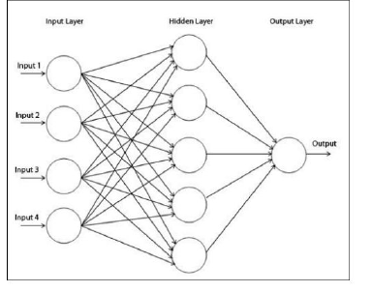
Artificial Neural Network

Slide 23
Long-Short Term Memory
LSTM is form of Recurrent Neural Network(RNN) which is capable of holding long term dependencies. LSTM can remember the information for long period of time.
A common LSTM unit is composed of a cell, an input gate, an output gate and a forget gate.
Cell: It is used to remember the values over arbitrary time intervals.
Input Gate: It decides which information to keep in the cell.
Output Gate: It is used to decide which part of cell state should be given as an output.
Forget Gate: It is used to decide which information to throw away from the cell.

Slide 24
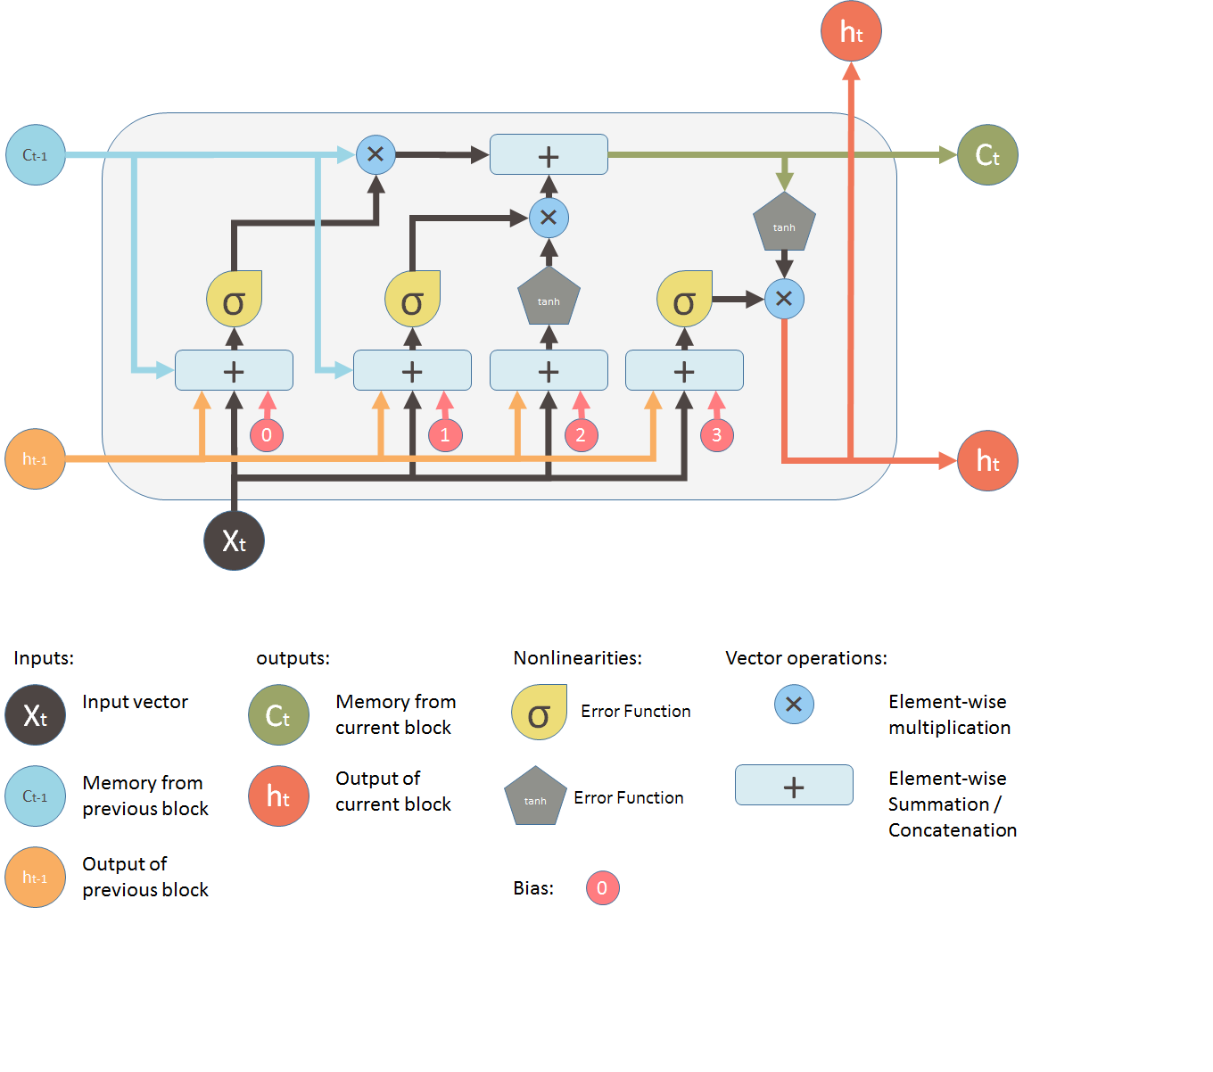
Long-Short Term Memory

Slide 25
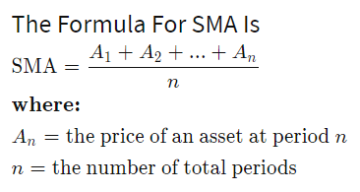
Technical Analysis
Simple Moving Average:

Slide 26
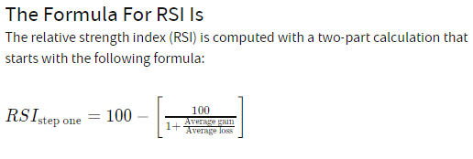
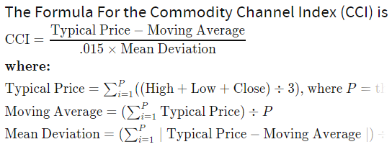
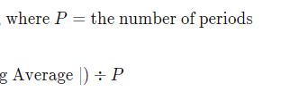
Relative Strength Index (RSI):
Commodity Channel Index :

Slide 27
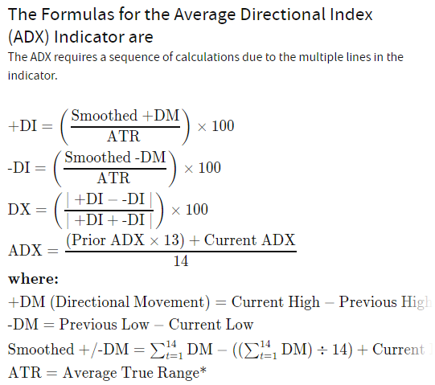
Average Directional Index(ADX) :

Slide 28
Sentimental Analysis:
Steps:
1. Data Collection:
2. Tokenizing:
3. Lemmatizing:
4. Finding Most Informative Features
5. Classifying features into positive and negative
6. Adding these features to the sentiment analyser lexicon
7. Classifying the testing data into positive and negative sentiments using training set.

Slide 29
…………….Thank you………….

